Slide 1

Data Science and Software Engineering Summit
Data Science & Software Engineering Communities
AXA Group Operations, 2023

Slide 2
Observability of cloud-native applications: A Whirlwind tour

Slide 3
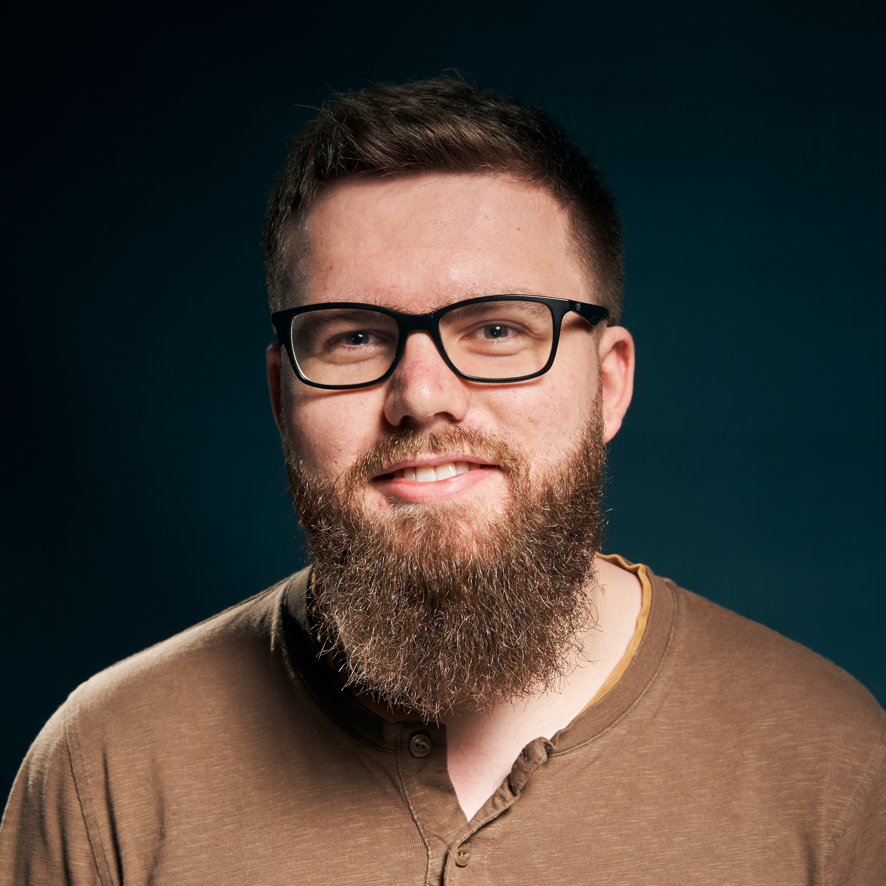


Jean-Lou Piermé Tech Leader at Axa France
I write code, sometimes
Mostly .NET & JS
.NET Community leader
@jloupiote
jlou

Slide 4

Disclaimer
Most of the slides have been generated with the powerpoint AI designer thing

Slide 5

Definition
Observability is the ability to measure the internal states of a system by examining its outputs. A system is considered “observable” if the current state can be estimated by only using information from outputs, namely sensor data.
From https://www.splunk.com/en_us/data-insider/what-is-observability.html

Slide 6
3 pillars of observability
Logs: Timestamped text record
Metrics: Numeric value that changes over time
(eg: total count of failed requests)
(Distributed) Traces: End-to-end view of a request

Slide 7
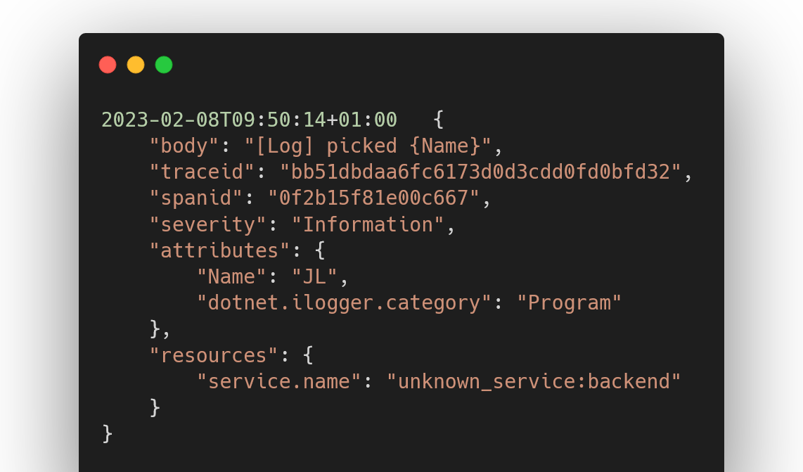
Logs: Timestamped text record
Notes:
2023-02-08T09:50:14+01:00 {
"body": "[Log] picked {Name}",
"traceid": "bb51dbdaa6fc6173d0d3cdd0fd0bfd32",
"spanid": "0f2b15f81e00c667",
"severity": "Information",
"attributes": {
"Name": "JL",
"dotnet.ilogger.category": "Program"
},
"resources": {
"service.name": "unknown_service:backend"
}
}

Slide 8
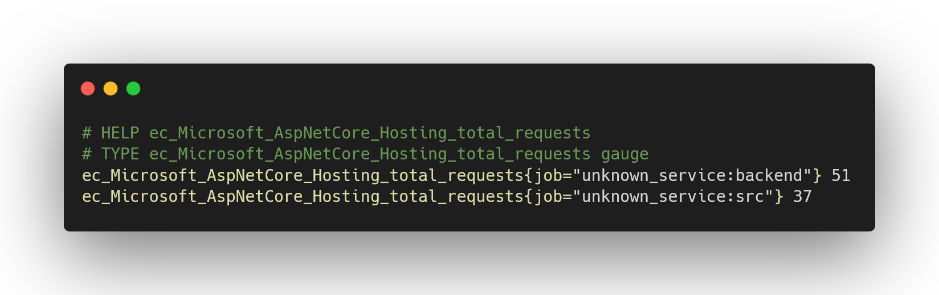
Metrics: Numeric value that changes over time (eg: total count of failed requests)
Notes:
# HELP ec_Microsoft_AspNetCore_Hosting_total_requests
# TYPE ec_Microsoft_AspNetCore_Hosting_total_requests gauge
ec_Microsoft_AspNetCore_Hosting_total_requests{job="unknown_service:backend"} 51
ec_Microsoft_AspNetCore_Hosting_total_requests{job="unknown_service:src"} 37

Slide 9
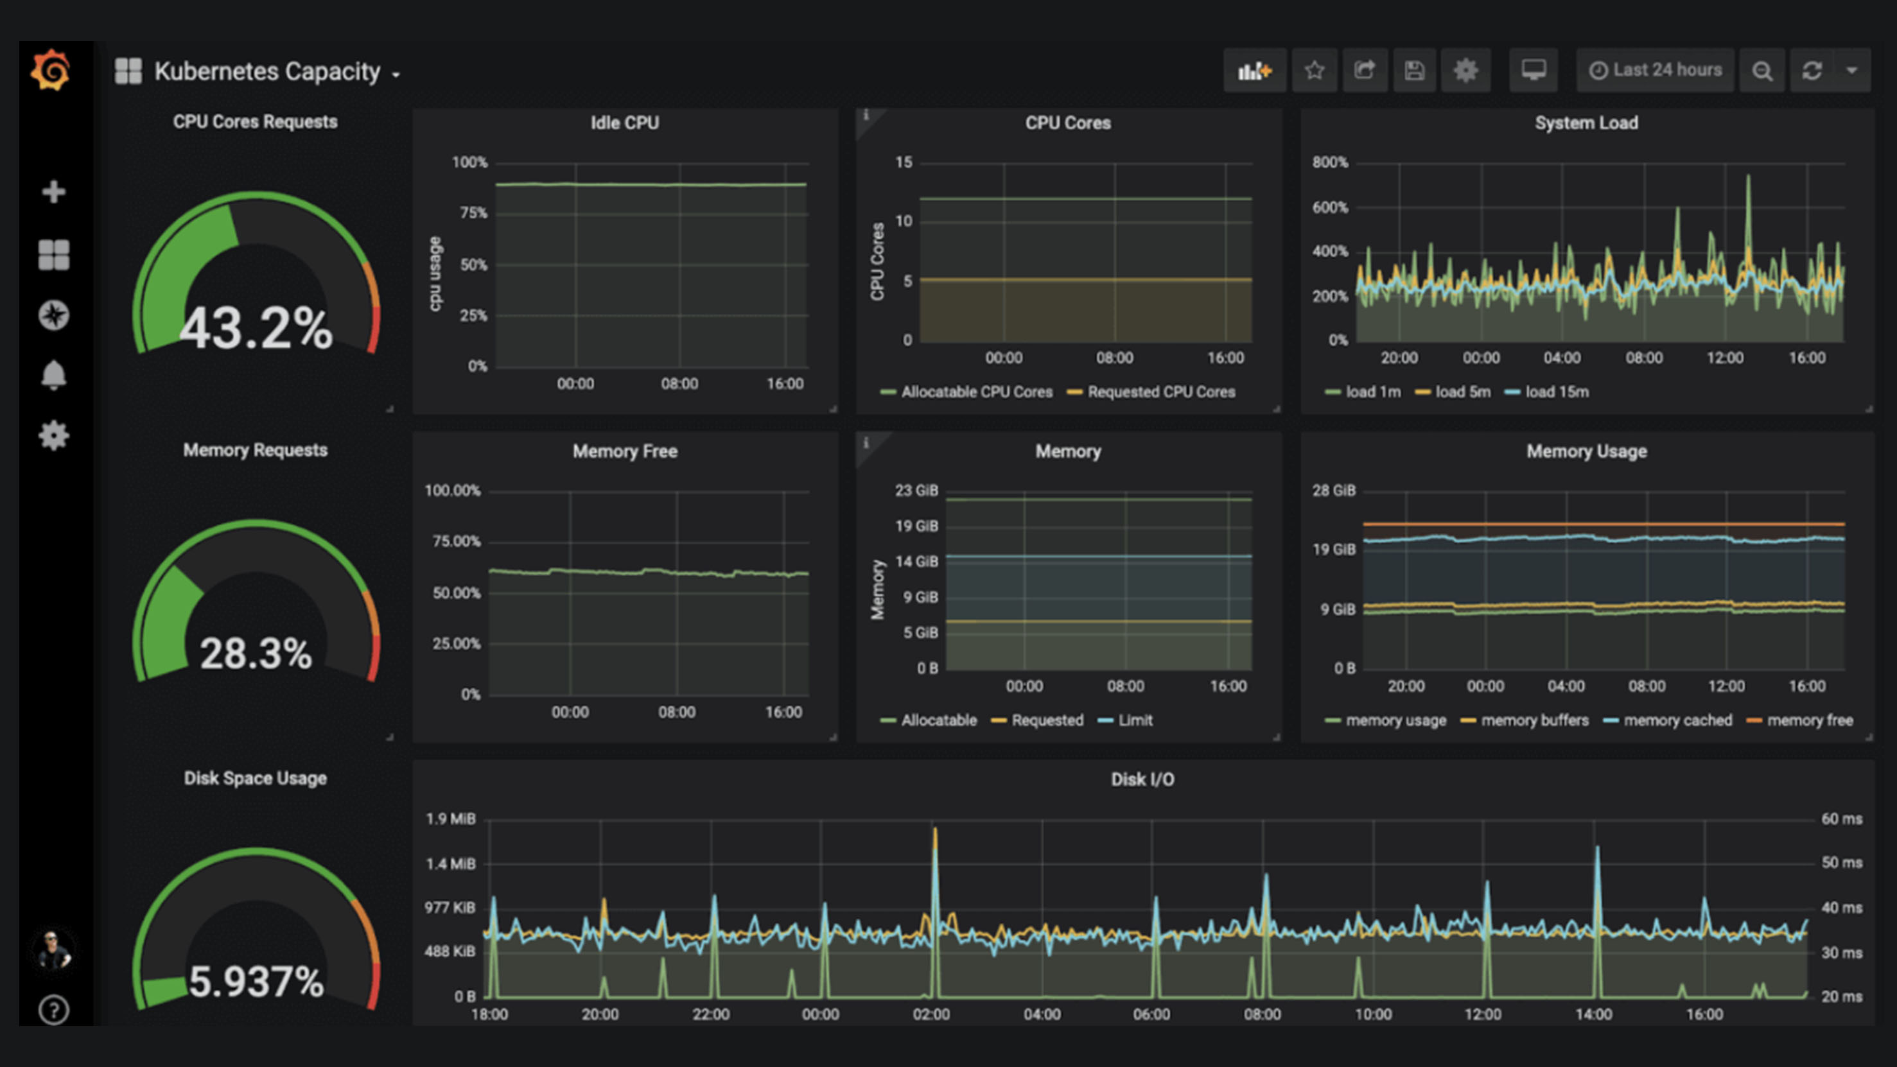

Slide 10
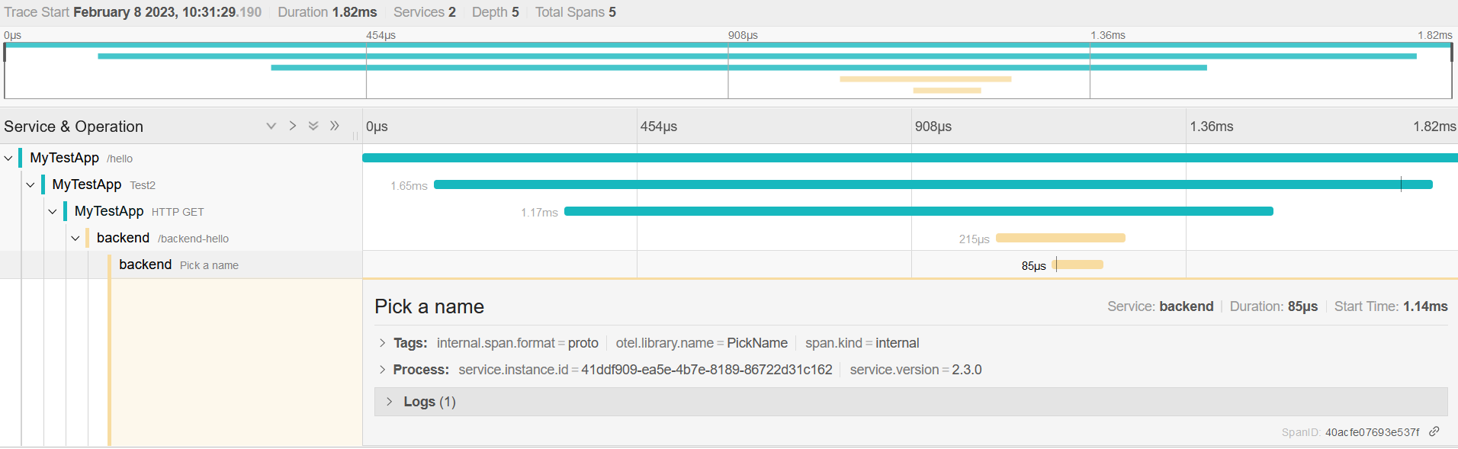
Traces Big picture of what happens when a request is made by a user or an application
Notes:
https://opentelemetry.io/docs/concepts/signals/traces/#spans-in-opentelemetry

Slide 11
The tools

Slide 12


Cloud-Vendors

Slide 13
And the rest
Datadog
Dynatrace
ELK (Elastic, Logstash, Kibana)
Grafana
Graphite
Honeycomb
InfluxDB
Instana
Jaeger
Lightstep
Prometheus
Sentry
Signoz
Zipkin
And a lot more…

Slide 14
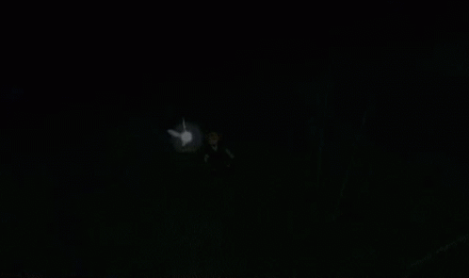

Slide 15
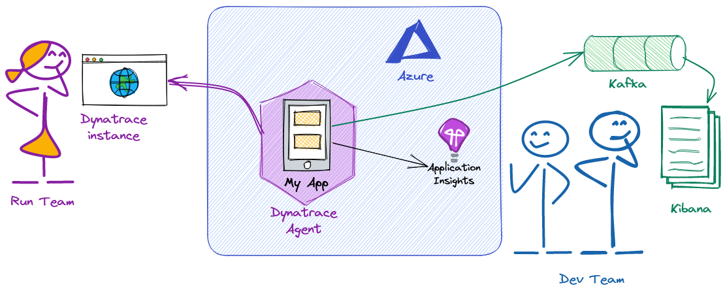
Typical AxaFrance application

Slide 16

One tool to rule them all
And in standard, bind them

Slide 17
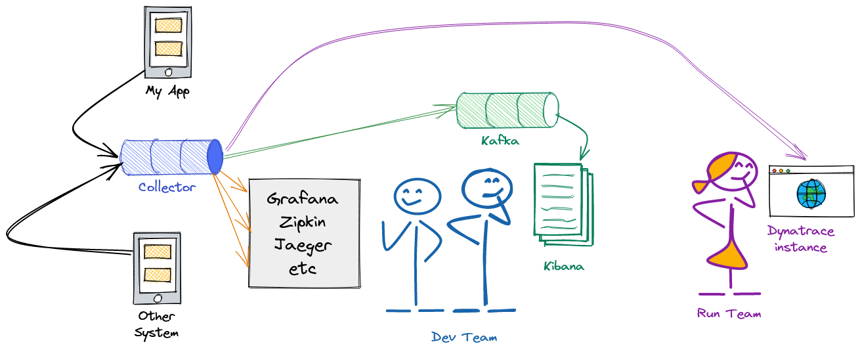
A unified future ?

Slide 18
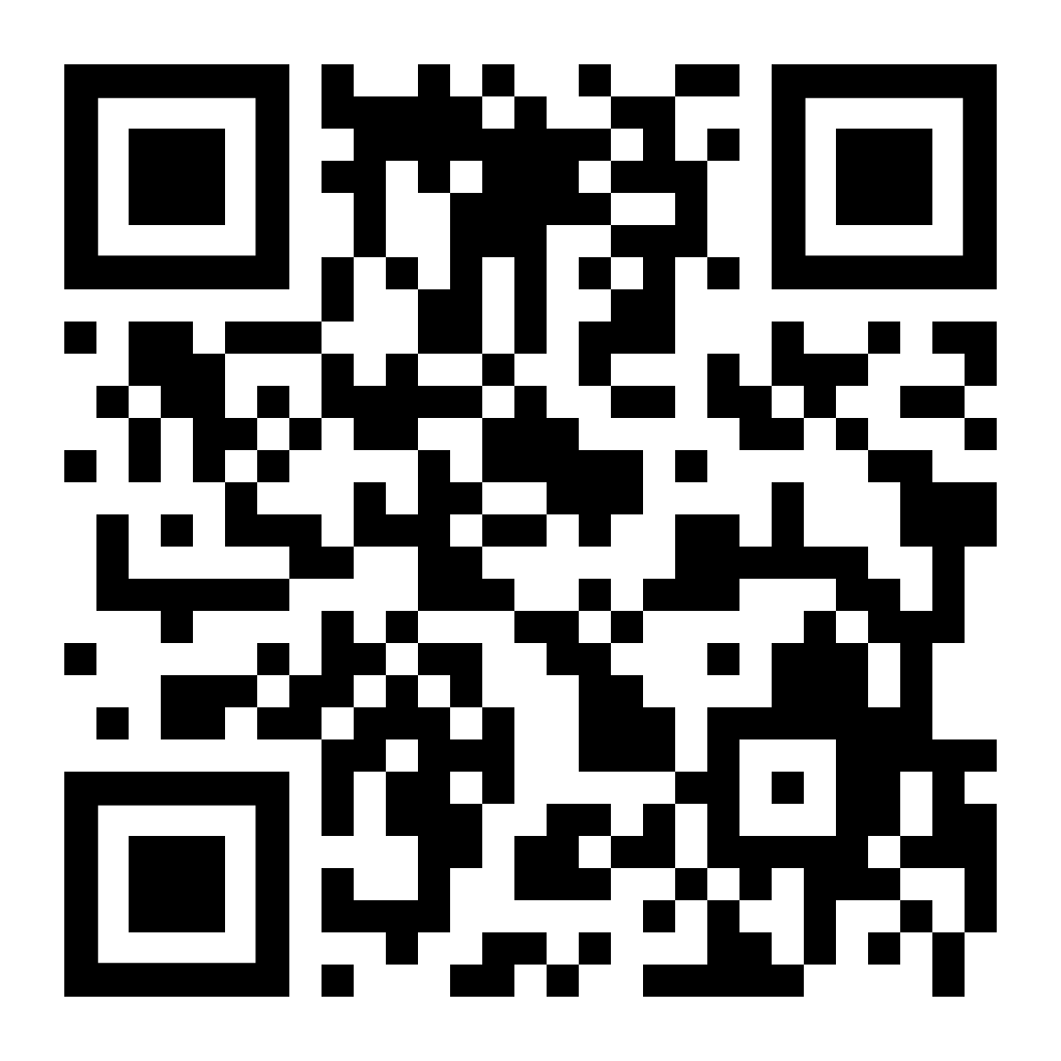
Sources and deck are available on github
https://github.com/JLou/talk-obervability

Slide 19



Q&A
Observability of cloud-native applications: A Whirlwind tour, 2023

Slide 20
THANK YOU!
Observability of cloud-native applications: A Whirlwind tour, 2023

